Slide 1
Math analysis
Day 33

Slide 2
Objective
Finish your custom Space Filling Curves
Continue Presentation
Work in Bricklayer-Lite or Codecademy

Slide 3
Part 2 Goal: Finish your own custom Curve to fill a 128x128 screen

Slide 4
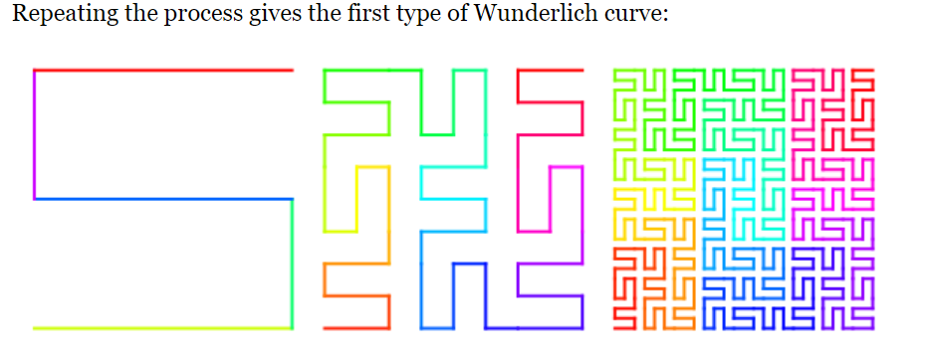
Some Ideas to Expand on this Concept:

Slide 5
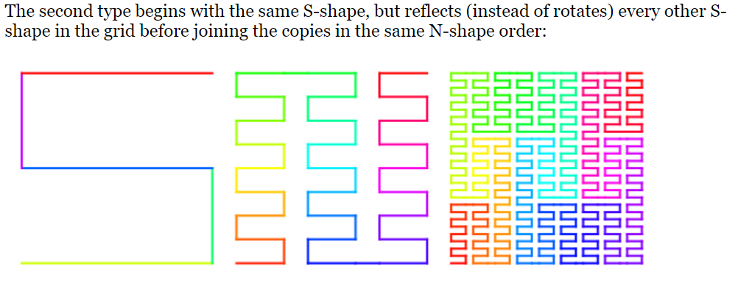
Some Ideas to Expand on this Concept:

Slide 6
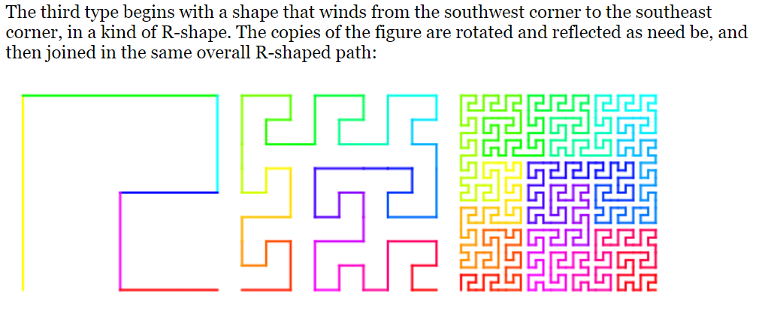
Some Ideas to Expand on this Concept:

Slide 7
Begin Presentation
Use the following slides as a guide to start collecting your work from this semester and save it on your flash drive, one drive, or TEAMS.
00_PRESENTATION FOR FINAL_IN PROGRESS is a folder for you to track your work

Slide 8
Presentations:
“Download your previous code from all past assignments (found on Teams in the folders)
Grab a screen shot using “Snipping Tool”of the image from The Grid or Bricklayer Lite
Grab a screen shot using “Snipping Tool”of a piece of the “code” from each image that shows a continued pattern through out, something you would improve upon now that you know more, and/or a common theme
Begin formatting your ‘thoughts’ for the essay portion of this grade… (in other words put into words the previous point)

Slide 9
Assignments to have screen shots from both your image, and a piece of your code
01_Patterns
02_Pixel Art
03_Saving in Bricklayer-Lite and/or 04_Objects in Bricklayer-Lite
05_Objects Around Bryan in Bricklayer Lite
06_Name_Project
07_Flag_Project
08_More_Patterns
10_Ring_Circle_Pattern
11_All_Functions
12_Real_Image
13_Space_Filling_Curves

Slide 10
Presentation Needs:
Image and code snippet (NOT the full code) from each project on previous slide
Brief description of what the code snippet did, and how you now know how to make it more efficient
Begin forming a Power Point presentation that shows your growth from your first project through the current project
Create an outline, to begin a short 5 paragraph essay styled paper, that will accompany presentation as the final. The paper will focus on your initial starting point/comfort level in the class, move on to where you are now, and what you anticipate for the future while supplying proof or examples of your own code to support your claims.

Slide 11
If you finish loading all your images, and outline…
Continue working in Codecademy or explore Code.org
Create something awesome in Bricklayer-Lite and upload it to the “00_Random Projects” folder on Teams

Slide 12
Review Saving in Bricklayer Lite to Teams
Change “Filename” make sure it ends with .xml
Click Download XML
Open up Teams
Open the appropriate folder: ______________________
Click “upload” and select your recently downloaded file
Save
*Move the file to your One Drive from your Downloads folder

